Slide 1
INSTAGRAM TOP-200 User analysis
ABISHEK K S
13-09-2023

Slide 2
SUMMARY
The analysis procedure is aimed to bring insights on the TOP-200 Instagram users
The dataset was obtained from Kaggle and is a relatively small dataset consisting of 200 Rows only.
The tech stack used is Power-BI, Openrefine (for Data Cleaning and faceting), SQLgate and Dbeaver for accessing MySQL(MariaDB) and Oracle databases.
Proof of working has also been attested within the report.

Slide 3
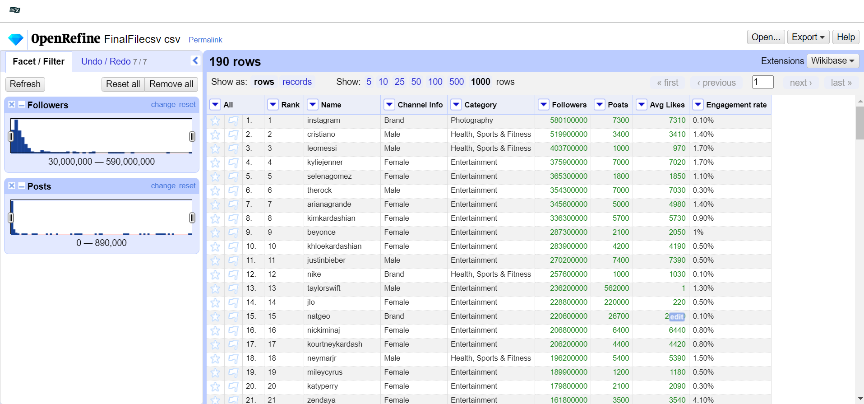
Open Refine – data cleaning and faceting

Slide 4
Open refine data cleaning
Open Refine was used to Clean the data. The following operations were performed :
1. Changing DT(Followers, Posts and Avg Likes) from Text to Numeric [ Numeric DT is indicated by the green color of text] using common transforms.
2. Observing facets/trends of followers and posts using In-Built numeric facet function.
3. Strings were properly formatted – ex: ‘b’ in ‘brands’ was changed to ‘B’.
4. ‘Category’ column strings were also properly formatted.

Slide 5
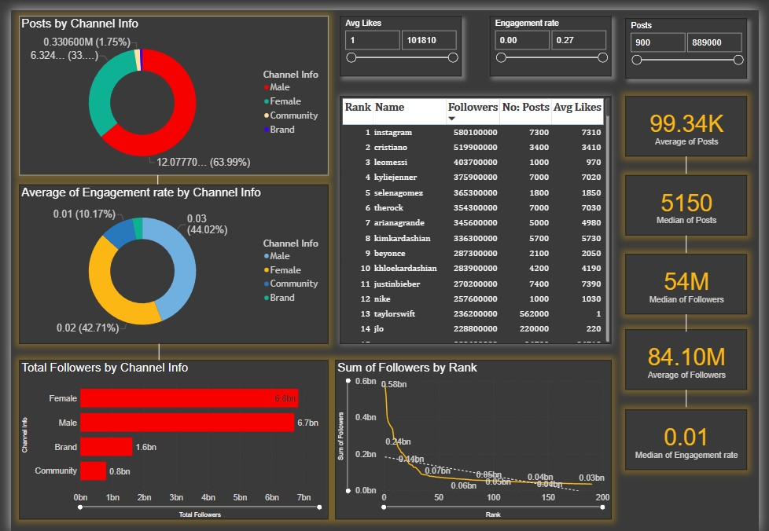
POWER BI DASHBOARD CREATION
Created a Power BI dashboard to carry out analysis.

Slide 6
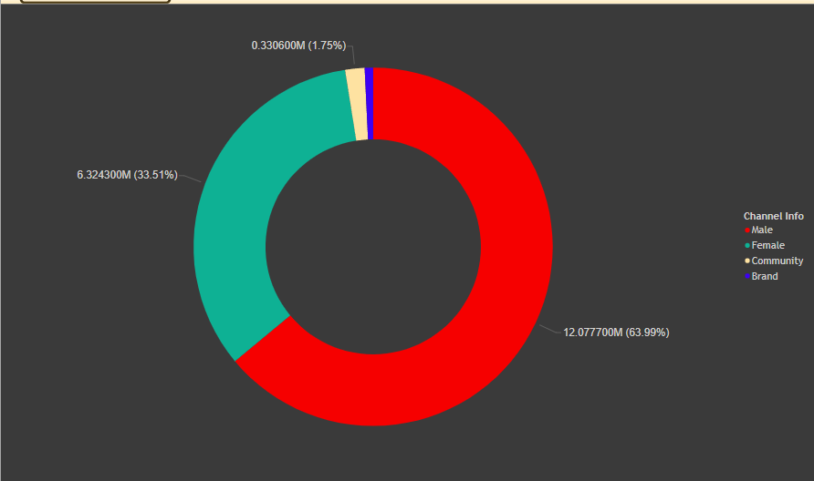
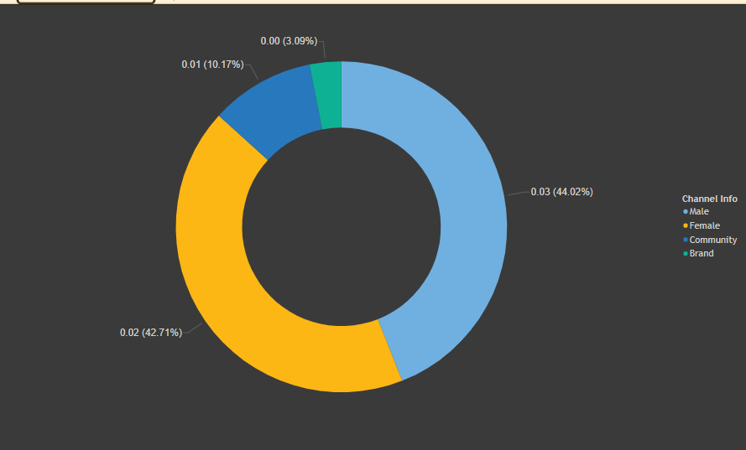
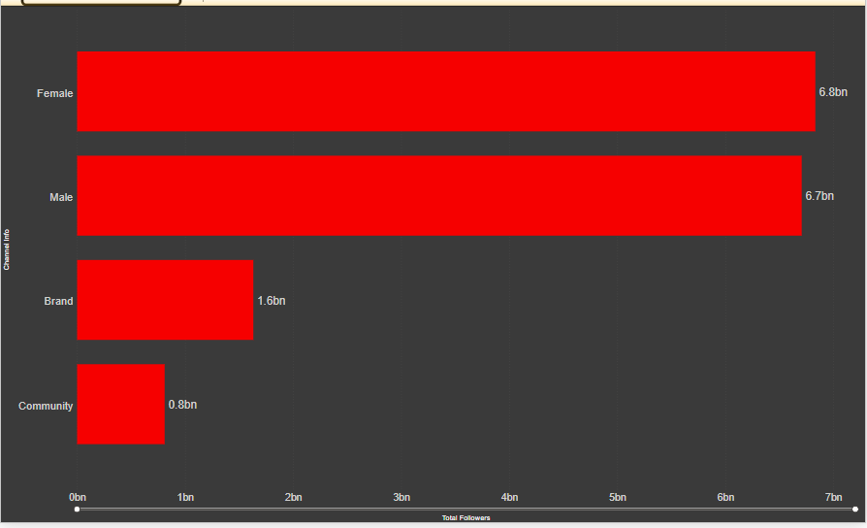
TRENDS
Male users in the top-200 list have the highest number of posts, followed by Females, Communities and brands in the 2nd ,3rd , and 4th positions respectively.
Male users have the highest engagement rate of 0.03, followed by females at 0.02 and Community pages at 0.01 respectively.
Females have the most number of followers at a total of 6.8 Billion, while males have a slightly lower cumulative follower count at 6.7 Billion.
Communities have the lowest total following, while brands are sandwiched between Males and Communities at 1.9 Billion.

Slide 7
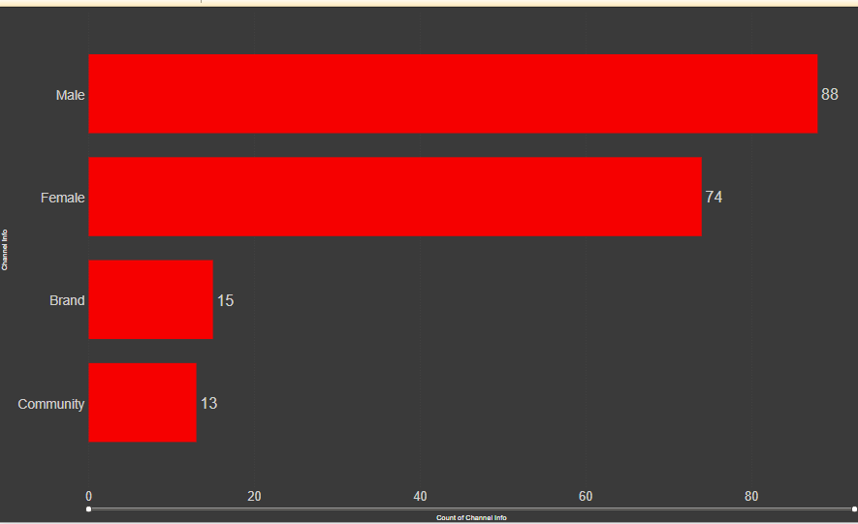
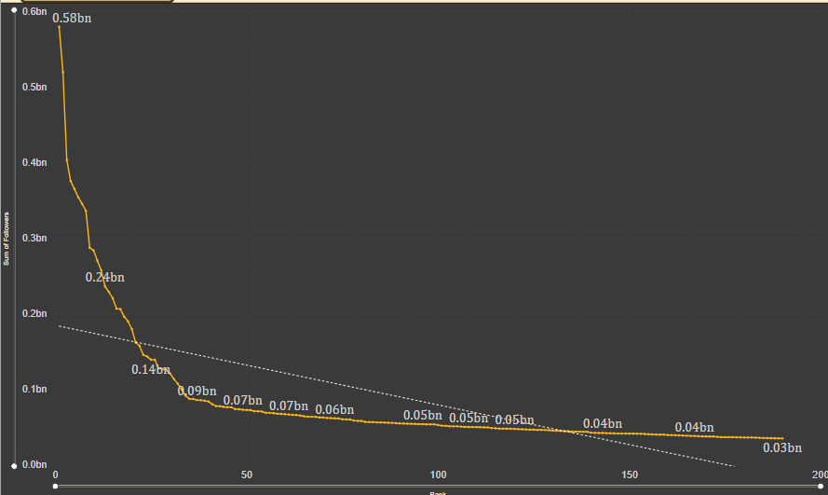
The distribution of the top 200 accounts are as follows :
1.Males – 88 accounts
2. Females- 74 accounts
3. Brands – 15 accounts
4. Communities – 13 accounts
The amount of followers follows an inverse-proportionality trend as seen from the Graph
The general trend of decrease is also seen.
Cristiano Ronaldo, Messi and The Rock are the top 3 followed Male influencers in the world.
Instagram has the most number of followers amongst brands, and Real Madrid, Barcelona and NASA have the most number of followers amongst communities.
Kylie Jenner, Selena Gomez Ariana Grande have the most number of followers in the female Category.

Slide 8
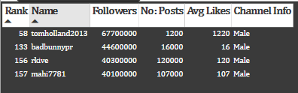
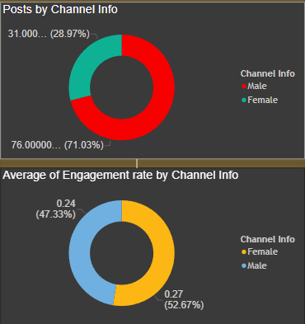
ENGAGEMENT RATE ANALYSIS
Engagement rate has been split into three ranks as a part of this analysis :
LER: Low Engagement rate [0.00 to 0.09] :
184 accounts have relatively low engagement rate in this range.
II. MER: Medium Engagement rate [0.09 to 0.18]:
Only 4 male accounts lie in this range.
III. HER: High Engagement Rate [0.18 to 0.27]:
A male account by the handle ‘thv’ has an
Avg ER of 0.24, followed by a female handle
‘j.m’ at the highest ER of 0.27.
IV. The male account still has the highest number of followers.

Slide 9
Table creation in db [Mysql-mariadb, oracle
ABSTRACT
We based our research on market trends and social media
DESIGN
We believe people need more products specifically dedicated to this niche market
RESEARCH
Minimalist and easy to use

Slide 10
MARKET OVERVIEW
$3 Billion
$1 Billion
$2 Billion
Freedom to invent
Selectively inclusive market
Serviceable available market
Opportunity to build
Fully inclusive market
Total addressable market
Few competitors
Specifically targeted market
Serviceable obtainable market

Slide 11
Market comparison
$3B
$2B
$1B
Opportunity to build
Freedom to invent
Few competitors
Addressable market
Serviceable market
Obtainable market

Slide 12
OUR COMPETITION
CONTOSO
COMPETITORS
Our product is priced below that of other companies on the market
Design is simple and easy to use, compared to the complex designs of the competitors
Affordability is the main draw for our consumers to our product
Company A Product is more expensive
Companies B & C Product is expensive and inconvenient to use
Companies D & E Product is affordable, but inconvenient to use

Slide 13
Our competition
Convenient
Contoso
Competitor A
Affordable
Expensive
Competitor D
Competitor C
Competitor B
Competitor E
Inconvenient

Slide 14
Growth strategy
Feb 20XX
Roll out product to high profile or top-level participants to help establish the product
Mar 20XX
Release the product to the general public and monitor press release and social media accounts
Oct 20XX
Gather feedback and adjust product design as necessary

Slide 15
TRACTION
Forecasting for success
Key Metrics
 | Clients | Orders | Gross revenue | Net revenue
20XX | 10 | 1100 | $10,000 | $7,000
20XX | 20 | 200 | $20,000 | $16,000
20XX | 30 | 300 | $30,000 | $25,000
20XX | 40 | 400 | $40,000 | $30,000
REVENUE BY YEAR

Slide 16
TWO-YEAR ACTION PLAN
DRAFT BLUEPRINTS
GATHER FEEDBACK
DELIVER TO CLIENT
20XX
JAN
FEB
MAR
APR
MAY
JUN
JUL
AUG
SEP
OCT
NOV
DEC
20XX
JAN
FEB
MAR
APR
MAY
JUN
JUL
AUG
SEP
OCT
NOV
DEC
RUN FOCUS GROUPS
TEST DESIGN
LAUNCH DESIGN

Slide 17
FINANCIALS
 | Year 1 | Year 2 | Year 3
INCOME
Users | 50,000 | 400,000 | 1,600,000
Sales | 500,000 | 4,000,000 | 16,000,000
Average price per sale | 75 | 80 | 90
Revenue @ 15% | 5,625,000 | 48,000,000 | 216,000,000
GROSS PROFIT | 5,625,000 | 48,000,000 | 216,000,000
Expenses
Sales & marketing | 5,062,500 | 38,400,000 | 151,200,000 | 70%
Customer service | 1,687,500 | 9,600,000 | 21,600,000 | 10%
Product development | 562,500 | 2,400,000 | 10,800,000 | 5%
Research | 281,250 | 2,400,000 | 4,320,000 | 2%
TOTAL EXPENSES | 7,593,750 | 52,800,000 | 187,920,000

Slide 18
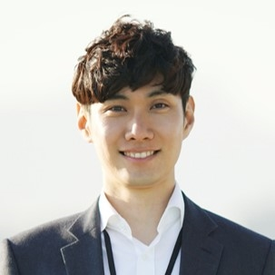



MEET THE TEAM
TAKUMA HAYASHI​
MIRJAM NILSSON​
FLORA BERGGREN​
RAJESH SANTOSHI​
President
Chief Executive Officer
Chief Operations Officer
VP Marketing

Slide 19
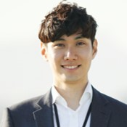







MEET THE TEAM
TAKUMA HAYASHI
MIRJAM NILSSON​
FLORA BERGGREN​
RAJESH SANTOSHI
President
Chief Executive Officer
Chief Operations Officer
VP Marketing
GRAHAM BARNES
ROWAN MURPHY
ELIZABETH MOORE
ROBIN KLINE
VP Product
SEO Strategist
Product Designer
Content Developer

Slide 20
FUNDING
$14,000
$12,000
$82,000
$32,000
ANGEL INVESTMENTS
PROPERTY
SHARES
CASH
Amount obtained through other investors
Revenue obtained from property rentals
Number of shares converted into USD
Liquid cash we have on hand

Slide 21
SUMMARY
At Contoso, we believe in giving 110%. By using our next-generation data architecture, we help organizations virtually manage agile workflows. We thrive because of our market knowledge and great team behind our product. As our CEO says, "Efficiencies will come from proactively transforming how we do business.”

Slide 22
THANK YOU
Mirjam Nilsson​
206-555-0146
mirjam@contoso.com
www.contoso.com

